Slide 1
Brain Tumor Detection using CNN
Presented by: Nasima Fridos,MCA

Slide 2
Introduction
Brain tumors can be life-threatening.
Early and accurate detection is crucial.
Manual MRI analysis is time-consuming.
CNN improves speed and accuracy in detection.
Supports doctors in better treatment planning.

Slide 3
Objective
To develop a deep learning model(CNN) for brain tumor detection.
To accurately classify MRI scans as Tumor or No Tumor.
To achieve high accuracy and reliability in predictions.
To support doctors in making faster clinical decisions.

Slide 4
Dataset
Source: Kaggle Brain Tumor MRI Dataset
Categories:Tumor and No Tumor
Dataset size:Several hundred MRI scans for training and testing
PreProcessing:Image resizing,normalization and augmentation

Slide 5
Model Architecture
Input Layer: MRI images resized to fixed dimensions
Convolutional Layers:Extract spatial features
Max Pooling Layers: Reduce dimensionality and overfitting
Flatten Layer: Converts feature maps into 1D vector
Dense Layers: Fully connected layers for classification
Output Layer: Softmax activation for binary classification(Tumor/No Tumor)

Slide 6
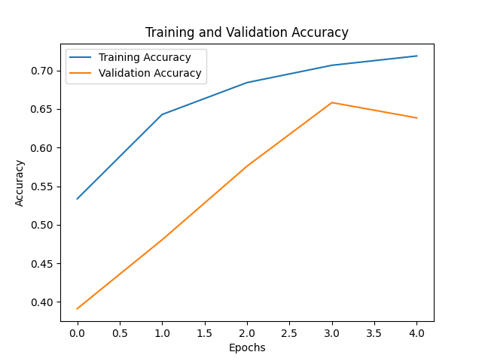
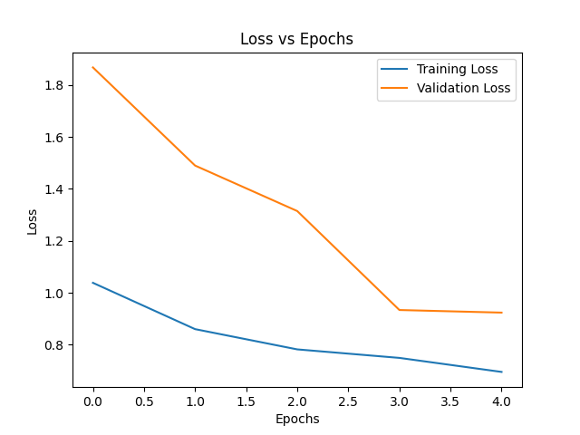
Training And Evaluation
Training Process: model trained for 5 epochs.
Accuracy: High accuracy on training and validation sets.
Loss Trends: Loss decreased steadily during training.

Slide 7
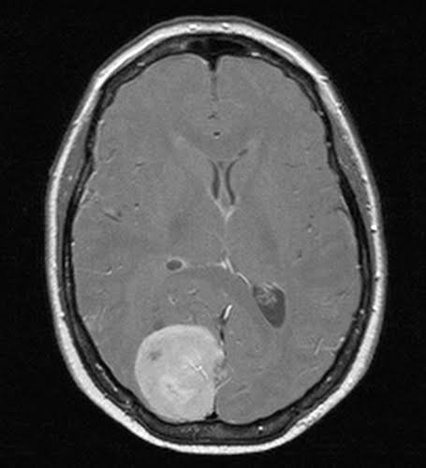
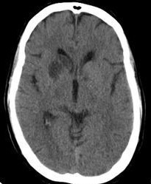
Results
Confusion matrix shows high classification accuracy.
Model achieved strong precision and recall across all classes.
Sample predictions demonstrate correct identification of tumor types and np tumor cases.
No Tumor
Tumor(Meningioma)

Slide 8
Conclusion
The proposed CNN model demonstrated strong capability in brain tumor detection from MRI scans.
Achieved high classification accuracy on both training and testing datasets.
The model can serve as a supportive diagnostic tool for healthcare professionals.

Slide 9
Future Scope
Enhanced model accuracy using advanced architectures(e.g., ResNet, EfficientNet).
Extend the system to classify multiple tumor types with higher precision.
Deploy as a clinical decision-support tool for real-time diagnosis.

Slide 10
References
Kaggle Brain Tumor Dataset - https://www.kaggle.com
Google Colab Environment - https://colab.research.google.c

